Slide 1
Advanced Database
Week 1 – Part 2

Slide 2
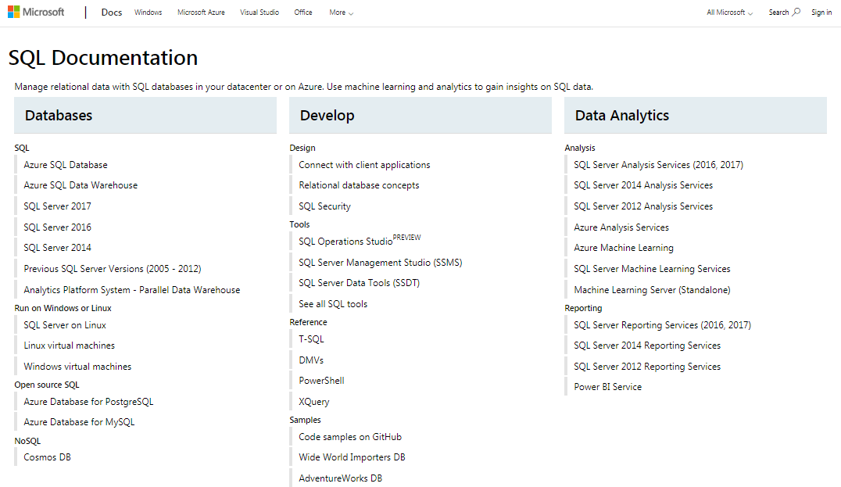
SQL official Website documentation
Course Resources
YouTube
Microsoft Website
W3School
Stackoverflow.com
LinkedIn learning (Lynda.com)
https://docs.microsoft.com/en-us/sql/?view=sql-server-2017

Slide 3
SQL Server Installation – Hands on
Click to Visit the website
The SQL Server Installation Wizard provides a single feature tree to install all SQL Server components:
Database Engine
Analysis Services
Reporting Services
Integration Services
Master Data Services
Data Quality Services
Connectivity components
https://docs.microsoft.com/en-us/sql/database-engine/install-windows/installation-for-sql-server?view=sql-server-2017

Slide 4

Connecting to SQL Server using SSMS - Part 1
A useful video on how to start the SSMS can be found on YouTube:
Click on the image. 9’:40”
https://youtu.be/ZNObiptSMSI?list=PL08903FB7ACA1C2FB

Slide 5
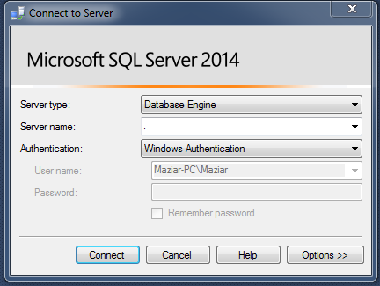
Add System Admin
After log-in:
1- Object Explorer → Security → logins → sa → right click → properties
2- status → login → enable
3- General → Change password → re-type password → OK → Refresh
4- Go to the top and right click on main server instance name.
5- properties → security → server authentication → select → SQL Server and windows authentication mode.
6- OK
7- restart the server (disconnect and connect again)

Slide 6
IN-Class task
Add two sample databases to your SSMS.
SIS
Simply get the ‘createSISdatabase’ file from “database” folder” in D2L.
Open SSMS and execute the query.
To get more details you can open the ‘SIS Implementation’ document. You can find it in week1 folder.
There might be a common error message. If you get that error message, read the Appendix I.
II) Adventureworks2014 or newer.
1- You can find the newer version on Microsoft website or you can use the file which has been uploaded in ‘Database’ folder.
2- Move the file to ‘backup – bak ’ folder in your computer.
3- Object Explorer → Database → Right click → restore database → General → Device → ellipses button → add → find the backup folder and click on the file → OK → OK
OK
4- Refresh your database.

Slide 7
Assignment

Slide 8
Appendix I
When adding the SIS database, if you get that error message:
Msg 102, Level 15, State 1, Line 136
Incorrect syntax near 'TRIPLE_DES'.
Add the following code after creating database in your script:
use master;
GO
ALTER DATABASE SIS
SET COMPATIBILITY_LEVEL = 120;
USE SIS;
GO

